Slide 1
Understanding Truthy and Falsy Values in JavaScript
By Nduka Asoh Obewu

Slide 2
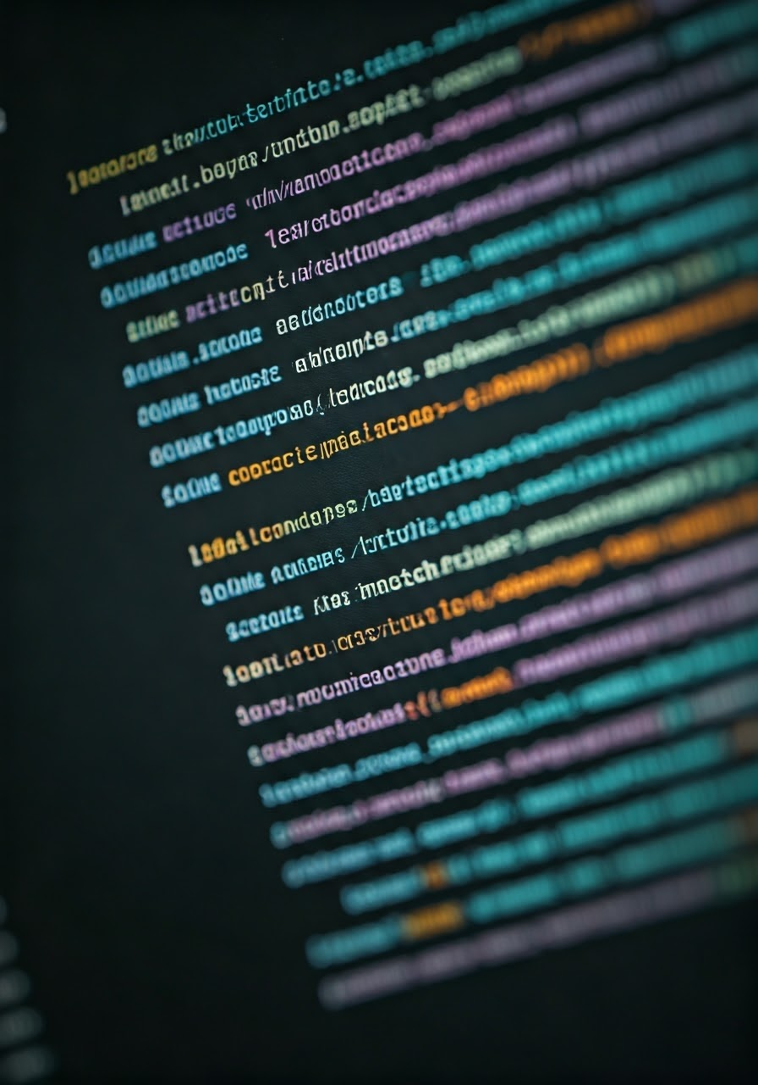
Introduction
In JavaScript, truthy and falsy values are concepts related to boolean evaluation. Every value in JavaScript has an inherent boolean "truthiness" or "falsiness," which means they can be implicitly evaluated to true or false in boolean contexts, such as in conditional statements or logical operations.

Slide 3

What Are Truthy Values?
Truthy values are values that are evaluated to be true when used in a Boolean context. Simply put, any value that is not explicitly falsy is considered truthy.
These are some truthy values
Non-zero numbers: 42, -1, 3.14
Non-empty strings: "hello", "0", " "
Objects and arrays: {}, []
Functions: function() {} 10n
Dates: new Date()
Symbols: Symbol()
BigInt values other than 0n: 10n

Slide 4

What Are Falsy Values?
Falsy values are values that evaluate to false when used in a Boolean. JavaScript has a fixed list of falsy values.
These are some Falsy values
false
0 (and -0)
0n (BigInt zero)
"" (empty string)
null
undefined
NaN
document. all (used for backward compatibility)

Slide 5
Difference Between Truthy and Falsy Values
Aspect | Truthy Values | Falsy Values
Definition | Values that evaluate to true in Boolean contexts. | Values that evaluate to false in Boolean contexts.
Examples | 42, "hello", {}, [], function() {} | false, 0, -0, "", null, undefined, NaN
Empty Structures | Empty objects {} and arrays [] are truthy. | Not applicable (empty structures are not falsy).
Strings | Non-empty strings (e.g., "hello", " ") are truthy. | Empty strings ("") are falsy.
Numbers | Non-zero numbers (e.g., 42, -3.14) are truthy. | Zero (0, -0) is falsy.
BigInt | Any non-zero BigInt value (e.g., 10n) is truthy. | Zero BigInt (0n) is falsy.
Usage in Logical Operators | Can short-circuit `

Slide 6

Conclusion
The concept of truthy and falsy values is important for writing concise and readable code, as it allows you to check for the existence or validity of a value without explicitly comparing it to true or false.

